Slide 1
Social and Political rights
Freedom of speech
Freedom of the press

Slide 2
We wanted to experience the lack of freedom of speech.
We pretended to be reporters being blackmailed because we discovered a fraud
Follow us to our adventures…

Slide 3
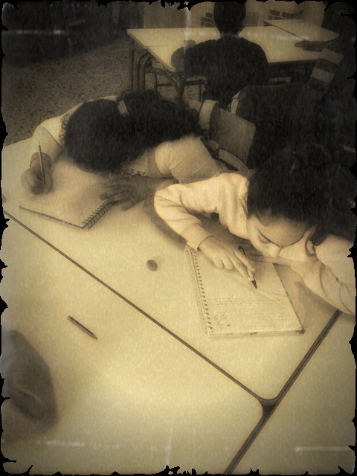
Niki’s report
“My name is Marianne and I am a journalist. I found out that the mayor kidnapped children. The mayor became aware of my discovery and payed a few men to blackmail me.”

Slide 4
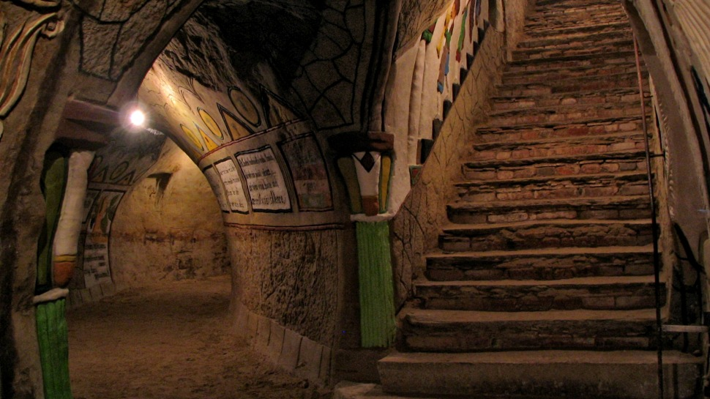
“They locked me into my warehouse. Fortunately, I had my iphone into my pocket so I called the police.”

Slide 5
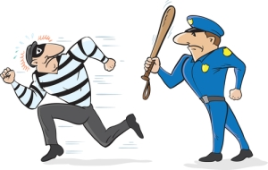
“A few police officers came and arrested the criminals and in the aftermath the mayor was also arrested.”

Slide 6
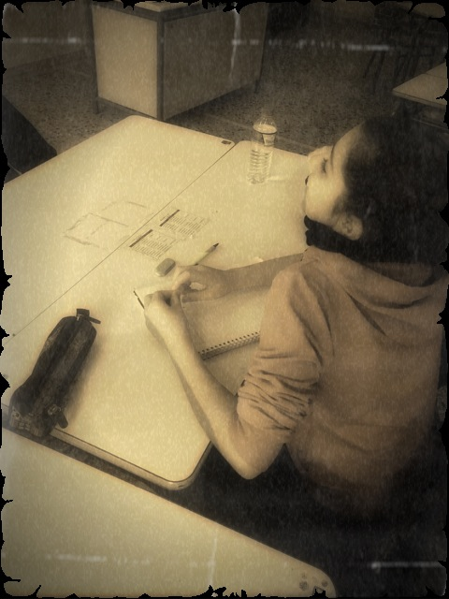
Eleni’s report
“I am Lina and I work as a reporter. I found out that in Africa foreign companies exploit local diamond production. They turned indigenous population into slaves.”

Slide 7
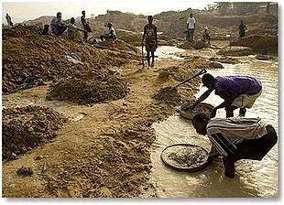

Slide 8
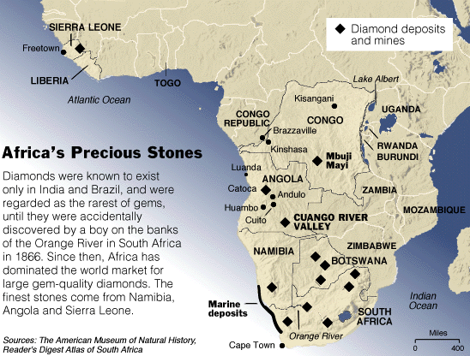
“A president of a company gave a command to his private army to abduct me. They put me into a warehouse somewhere in Kongo. Finally I managed to escape and I wrote a story about Africa’s diamonds.”

Slide 9
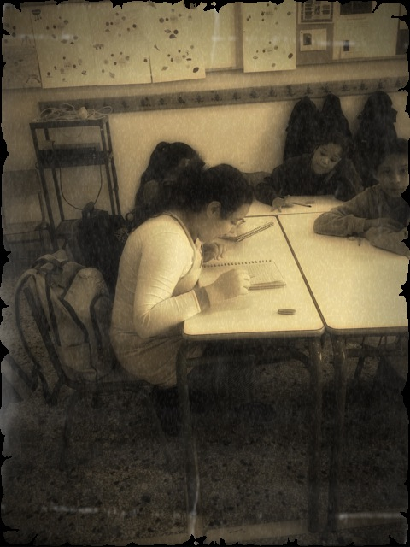
Vasiliki’s report
“I am Elina and I am a reporter. I found out that in a nuclear power factory they imprison foreign people and they use them for their researches.”

Slide 10
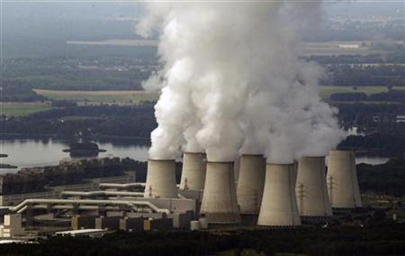
“When the owner of the factory became aware of my discovery he sent 5 men to abduct me. Fortunately I had a hairgrip and I released myself. I wrote a story about my adventure and all the factory’s slaves became free!

Slide 11
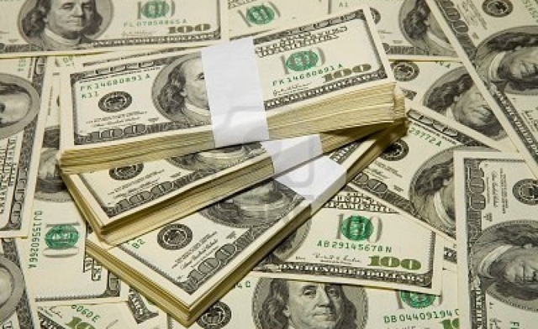
Panagiotis report
“ I am Panagiotis and I found out that in America some powerful people had stolen billions of dollars. Unfortunately they found out that I knew it all about their fraud.”

Slide 12
“They abducted me and they locked me into a warehouse. I screamed for help but nobody was there to help me. When it got dark outside a helicopter appeared and took me away saving my life. I went to the TV station where I worked and told my story to everyone”

